Slide 1
Safety and security report: August 2019
Forest Park Southeast, Botanical Heights, Central West End, Medical Campus

Slide 2
Summary Notes: FPSE August 2019
32 Total Crimes
21% increase compared to August 2018 (19 crimes)
Decreased: assault
Increased: arson, larceny
No change: burglary, homicide, motor vehicle theft, robbery
1 crimes against persons (0 assaults, 1 robberies)
75% decrease compared to August 2018 (4 crimes)
Crime occurred most frequently on Thursdays
166 total crimes so far in 2019
25% increase compared to this point in 2018 (133 crimes)
Decreased: assault, burglary, homicide,
Increased: arson, larceny, motor vehicle theft, robbery
27 crimes against persons so far this year
25% decrease compared to this point in 2018 (36 crimes)

Slide 3
Comparing 2018 and 2019: FPSE
2018
Part 1 Crimes | January | February | March | April | May | June | August | August | September | October | November | December | Total
Aggravated Assault | 2 | 2 | 0 | 3 | 7 | 5 | 4 | 3 | 1 | 7 | 0 | 3 | 37
Arson | 0 | 0 | 1 | 0 | 0 | 0 | 0 | 0 | 0 | 0 | 0 | 0 | 1
Burgalry | 0 | 1 | 1 | 3 | 0 | 1 | 1 | 1 | 0 | 1 | 0 | 0 | 9
Homicide | 1 | 0 | 0 | 0 | 0 | 0 | 0 | 0 | 0 | 0 | 0 | 0 | 1
Larceny | 5 | 3 | 6 | 7 | 20 | 5 | 13 | 12 | 14 | 9 | 10 | 3 | 107
Motor Vehicle Theft | 2 | 1 | 2 | 0 | 3 | 3 | 3 | 2 | 2 | 2 | 2 | 2 | 24
Robbery | 0 | 0 | 1 | 1 | 1 | 4 | 2 | 1 | 0 | 2 | 1 | 2 | 15
Total | 10 | 7 | 11 | 14 | 31 | 18 | 23 | 19 | 17 | 21 | 13 | 10 | 194
2019
Part 1 Crimes | January | February | March | April | May | June | August | August |  |  |  |  | Total | M/M Change | YTD Change
Aggravated Assault | 0 | 3 | 1 | 2 | 2 | 4 | 2 | 0 |  |  |  |  | 14 | -100% | -46%
Arson | 0 | 0 | 1 | 0 | 0 | 0 | 1 | 1 |  |  |  |  | 2 | 100% | 100%
Burgalry | 0 | 0 | 1 | 1 | 0 | 0 | 3 | 1 |  |  |  |  | 6 | 0% | -25%
Homicide | 0 | 0 | 0 | 0 | 0 | 0 | 0 | 0 |  |  |  |  | 0 | 0% | -100%
Larceny | 8 | 10 | 14 | 12 | 8 | 20 | 17 | 19 |  |  |  |  | 108 | 58% | 52%
Motor Vehicle Theft | 3 | 6 | 1 | 2 | 0 | 2 | 7 | 2 |  |  |  |  | 23 | 0% | 44%
Robbery | 1 | 0 | 1 | 1 | 2 | 5 | 2 | 1 |  |  |  |  | 13 | 0% | 30%
Total | 12 | 19 | 19 | 18 | 12 | 31 | 32 | 23 |  |  |  |  | 166 | 21% | 25%

Slide 4
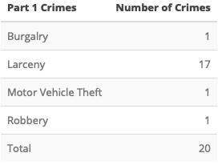
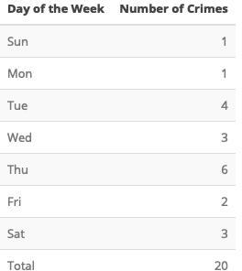
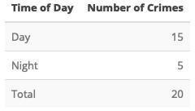
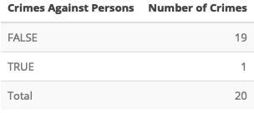
Forest Park Southeast: August 2019

Slide 5
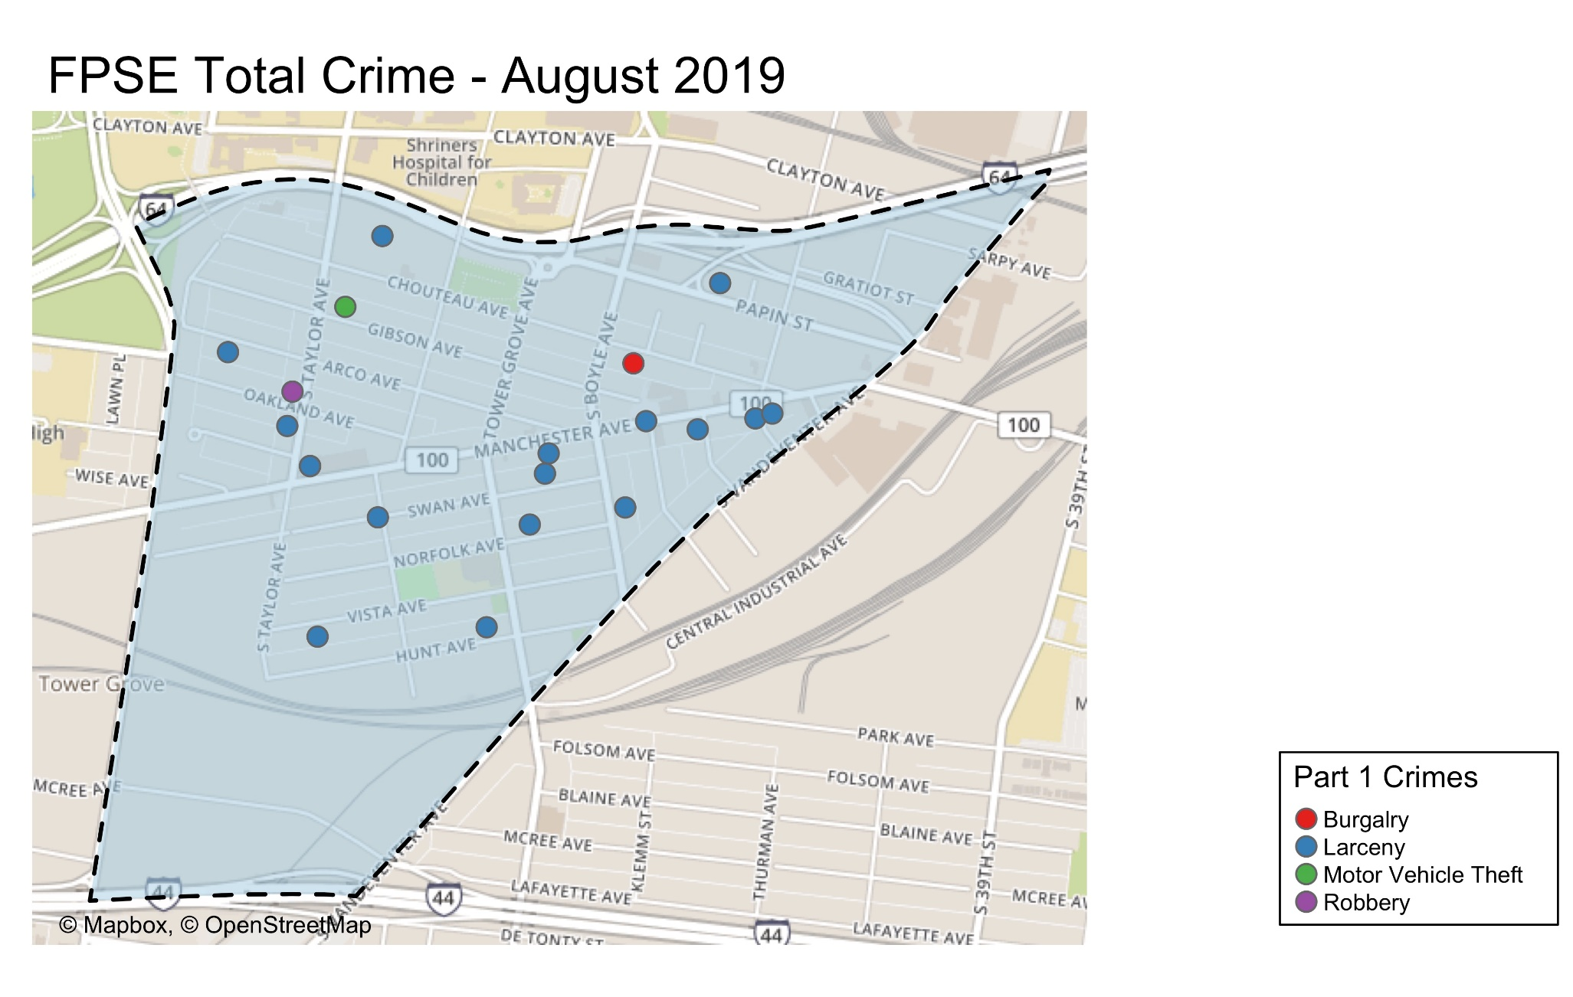

Slide 6
Appendix 1 Links
FPSE Day/Night
FPSE Crimes Against Persons
Grove CID
FPSE Density Map
FPSE Larceny Breakdown
FSPE Crime by Day of Week
FPSE Crime by Time of Day
FPSE Crime by Category and Day

Slide 7
Summary Notes: Botanical Heights August 2019
10 Total Crimes
78.00% decrease compared to August 2018 (18 crimes)
Decreased: burglary, larceny, robbery
Increased: assault
No change:
1 crime against persons
100% increase compared to August 2018 (0 crimes)
Crime occurred most frequently on Saturdays.
53 total crimes so far in 2019
32% decrease compared to this point in 2018 (78 crimes)
Decreased: burglary, larceny, motor vehicle theft
Increased: robbery
No change: assault, homicide, rape
9 crimes against persons so far this year
28% increase compared to this point in 2018 (7 crimes)

Slide 8
Comparing 2018 and 2019: Botanical Heights
2018
Part 1 Crimes | January | February | March | April | May | June | July | August | September | October | November | December | Total
Aggravated Assault | 0 | 0 | 1 | 1 | 1 | 2 | 0 | 0 | 0 | 0 | 1 | 1 | 7
Burgalry | 1 | 2 | 0 | 1 | 3 | 2 | 0 | 8 | 3 | 4 | 2 | 5 | 31
Larceny | 14 | 1 | 6 | 0 | 4 | 6 | 6 | 8 | 6 | 4 | 3 | 3 | 61
Motor Vehicle Theft | 4 | 0 | 1 | 0 | 1 | 0 | 2 | 1 | 0 | 0 | 2 | 0 | 11
Robbery | 1 | 0 | 0 | 0 | 0 | 0 | 0 | 1 | 0 | 0 | 0 | 0 | 2
Total | 20 | 3 | 8 | 2 | 9 | 10 | 8 | 18 | 9 | 8 | 8 | 9 | 112
2019
Part 1 Crimes | January | February | March | April | May | June | July | August |  |  |  |  | Total | M/M Change | YTD Change
Aggravated Assault | 0 | 0 | 0 | 0 | 4 | 0 | 0 | 1 |  |  |  |  | 5 | 100% | 0%
Burgalry | 2 | 0 | 0 | 2 | 0 | 0 | 1 | 1 |  |  |  |  | 6 | -88% | -65%
Larceny | 0 | 5 | 6 | 3 | 3 | 3 | 9 | 1 |  |  |  |  | 30 | -88% | -33%
Motor Vehicle Theft | 1 | 1 | 3 | 0 | 1 | 1 | 0 | 1 |  |  |  |  | 8 | 0% | -11%
Robbery | 0 | 2 | 0 | 0 | 1 | 1 | 0 | 0 |  |  |  |  | 4 | -100% | 100%
Total | 3 | 8 | 9 | 5 | 9 | 5 | 10 | 4 |  |  |  |  | 53 | -78% | -32%

Slide 9
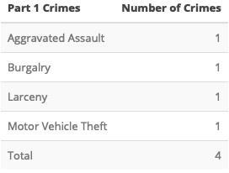
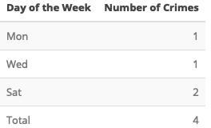
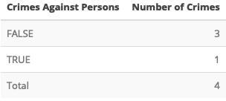
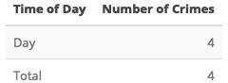
Botanical Heights: August 2019

Slide 10
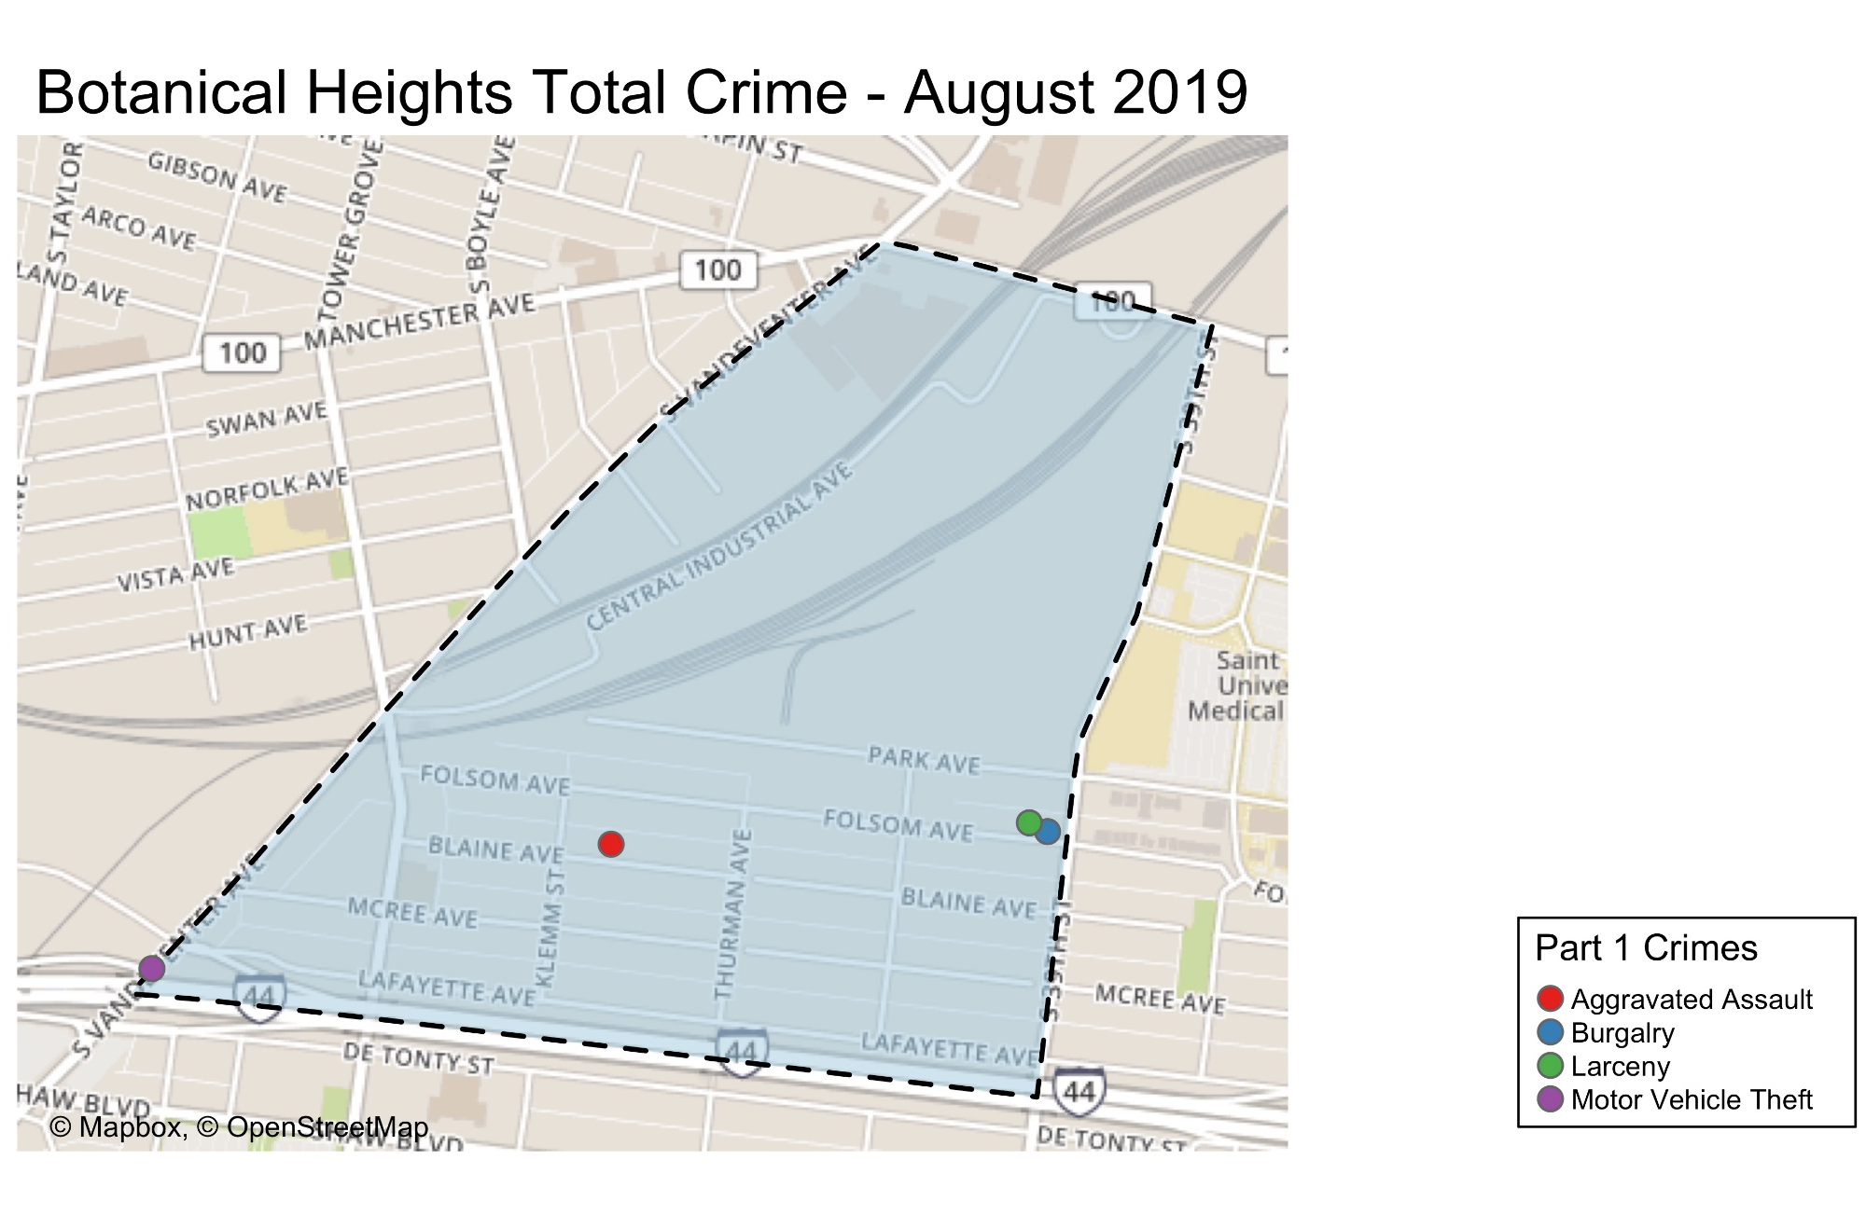

Slide 11
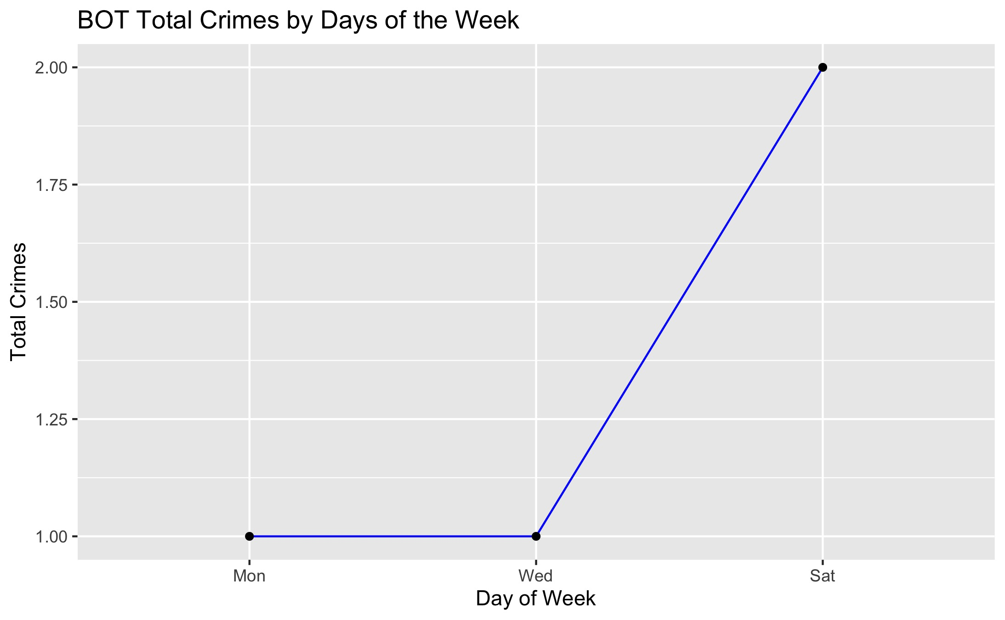

Slide 12
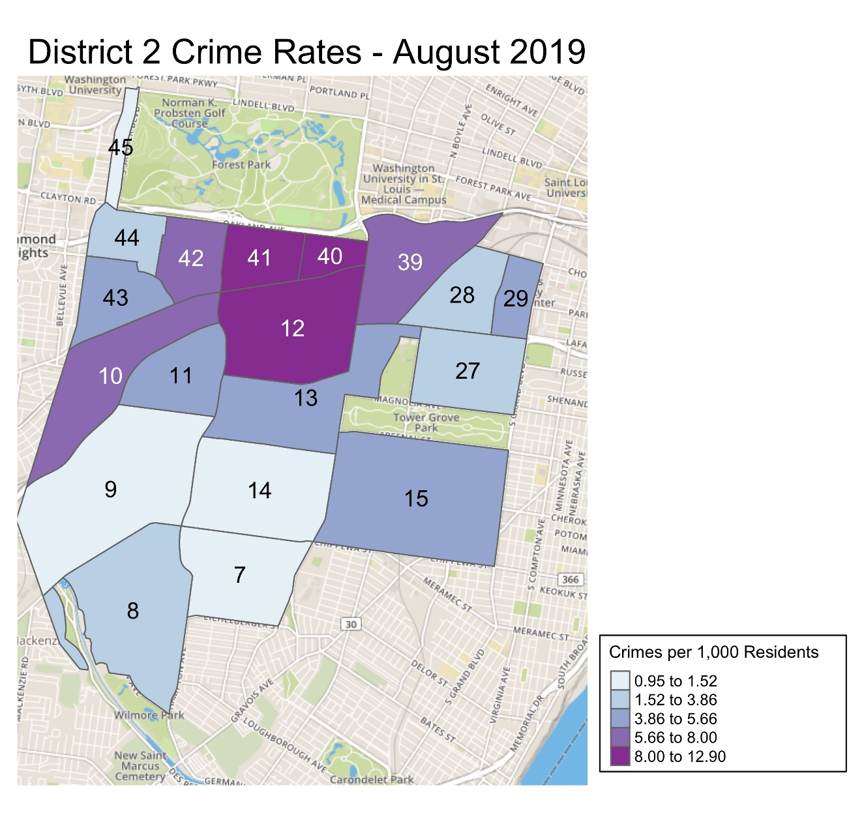
Notes:
South Hampton neighborhood is split between District 1 and District 2.

Slide 13
District 2 Density Map Explanation
District 2
There are 23 neighborhoods in District 2. The South Hampton neighborhood is split between District 2 and District 1
The minimum number of crimes in one neighborhood was 1 (Wydown Skinker, Wilmore Park).
The maximum number of crimes in one neighborhood was 72 (Tower Grove South).
The mean number of crimes per neighborhood was 15.2.
Crime Rate
The crime rate was calculated per 1,000 people using 2010 census data. Crime rates were not calculated for Forest Park, Tower Grove Park, Willmore Park or the Botanical Gardens due to negligible populations.
The minimum crime rate was .94 crimes per 1,000 people (Wydown Skinker).
The maximum crime rate was 12.9 crimes per 1,000 people (Cheltenham).
The mean crime rate was 5.28 crimes per 1,000 people (this mean rate does not include Forest Park, Tower Grove Park, Wilmore Park).

Slide 14
Summary Notes: CWE August 2019
125 Total Crimes
9% decrease compared to August 2018 (122 crimes)
Decreased: larceny, robbery
Increased: assault, burglary, motor vehicle theft, robbery
No change: arson, homicide
18 crimes against persons (10 assaults, 8 robberies)
38% increase compared to August 2018 (13 crimes)
Crime occurred most frequently on Fridays.
770 total crimes so far in 2019
9% decrease compared to this point in 2018 (848 crimes)
Decreased: homicide, larceny, robbery
Increased: assault, auto theft, burglary
No change: arson, rape
83 crimes against persons so far in 2019
15.27% increase compared to this point in 2018 (72 crimes)

Slide 15
CWE: Comparing 2018 and 2019
2018
Part 1 Crimes | January | February | March | April | May | June | August | August | September | October | November | December | Total
Aggravated Assault | 7 | 0 | 1 | 7 | 6 | 11 | 6 | 4 | 7 | 4 | 4 | 10 | 67
Arson | 0 | 0 | 0 | 0 | 0 | 0 | 0 | 0 | 0 | 0 | 0 | 0 | 0
Burgalry | 4 | 5 | 6 | 7 | 6 | 13 | 10 | 15 | 7 | 9 | 11 | 2 | 95
Homicide | 1 | 0 | 0 | 0 | 0 | 0 | 0 | 0 | 0 | 0 | 0 | 0 | 1
Larceny | 95 | 61 | 52 | 53 | 65 | 90 | 131 | 89 | 75 | 82 | 60 | 53 | 906
Motor Vehicle Theft | 9 | 6 | 7 | 9 | 12 | 6 | 6 | 5 | 10 | 12 | 6 | 9 | 97
Robbery | 2 | 2 | 8 | 10 | 1 | 8 | 3 | 9 | 6 | 8 | 5 | 6 | 68
Total | 118 | 74 | 74 | 86 | 90 | 128 | 156 | 122 | 105 | 115 | 86 | 80 | 1234
2019
Part 1 Crimes | January | February | March | April | May | June | August | August |  |  |  |  | Total | M/M Change | YTD Change
Aggravated Assault | 8 | 4 | 10 | 3 | 8 | 14 | 4 | 10 |  |  |  |  | 61 | 150% | 45%
Arson | 0 | 0 | 1 | 0 | 0 | 0 | 0 | 0 |  |  |  |  | 1 | 0% | 0%
Burgalry | 3 | 5 | 5 | 9 | 13 | 7 | 12 | 18 |  |  |  |  | 72 | 20% | 9%
Homicide | 0 | 0 | 0 | 0 | 0 | 0 | 0 | 0 |  |  |  |  | 0 | 0% | -100%
Larceny | 49 | 63 | 65 | 66 | 68 | 60 | 76 | 78 |  |  |  |  | 525 | -12% | -17%
Motor Vehicle Theft | 12 | 8 | 3 | 10 | 12 | 10 | 5 | 11 |  |  |  |  | 71 | 120% | 18%
Robbery | 5 | 5 | 2 | 6 | 7 | 3 | 4 | 8 |  |  |  |  | 40 | -11% | -7%
Total | 77 | 85 | 86 | 94 | 108 | 94 | 101 | 125 |  |  |  |  | 770 | 2% | -9%

Slide 16
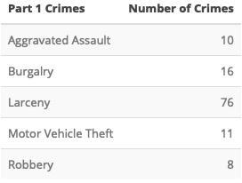
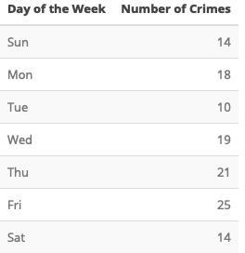
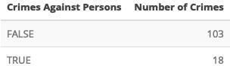
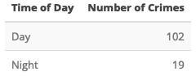
Central West End: August 2019

Slide 17
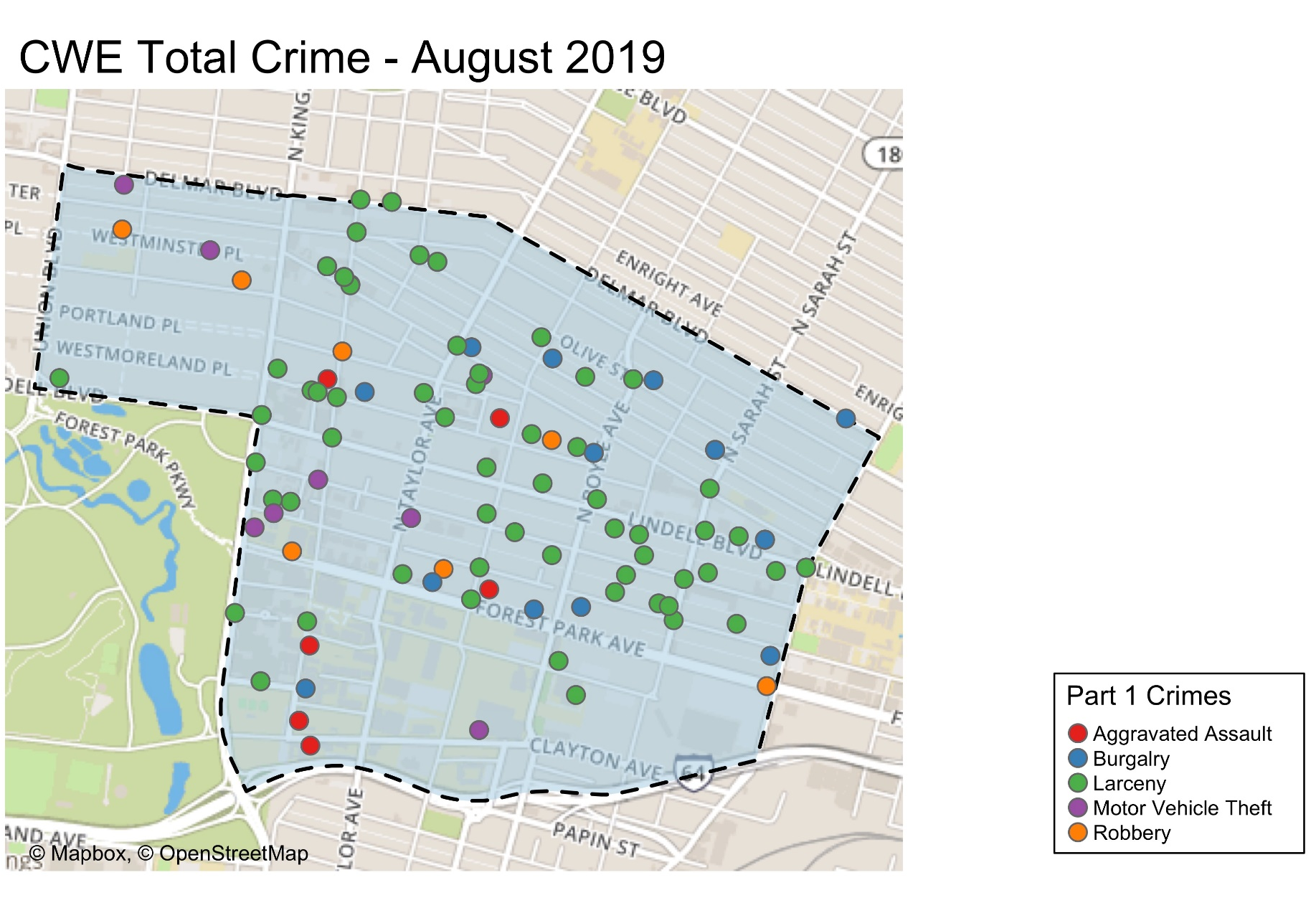

Slide 18
Appendix 2 Links
CWE Day/ Night Crimes
CWE Crimes Against Persons
CWE Density Map
CWE Larceny Breakdown
CWE Crime by Day of Week
CWE Crime by Time of Day
CWE Crime by Category and Day

Slide 19
Washington University Medical Campus: August 2019
12 Total Crimes
200.00% increase compared to August 2018 (4 crimes).
Decreased:
Increased: assault, burglary, motor vehicle theft, robbery
No change: homicide, larceny
6 crimes against persons
100% decrease compared to August 2018 (0 crimes)
67 total crimes so far in 2019
39% increase compared to this point in 2018 (93 crimes)
Decreased: homicide
Increased: assault, motor vehicle theft, larceny, robbery
No change: burglary

Slide 20
WUMC Campus: Comparing 2018 and 2019
2018
Part 1 Crimes | January | February | March | April | May | June | July | August | September | October | November | December | Total
Aggravated Assault | 4 | 0 | 1 | 0 | 0 | 1 | 0 | 0 | 0 | 0 | 0 | 1 | 7
Homicide | 1 | 0 | 0 | 0 | 0 | 0 | 0 | 0 | 0 | 0 | 0 | 0 | 1
burglary | 0 | 0 | 0 | 0 | 0 | 0 | 0 | 0 | 0 | 0 | 0 | 0 | 0
Larceny | 13 | 8 | 9 | 10 | 3 | 4 | 2 | 4 | 8 | 5 | 3 | 8 | 77
Motor Vehicle Theft | 1 | 0 | 1 | 2 | 2 | 0 | 0 | 0 | 1 | 3 | 3 | 0 | 13
Robbery | 0 | 0 | 0 | 1 | 0 | 0 | 0 | 0 | 1 | 0 | 1 | 0 | 3
Total | 19 | 8 | 11 | 13 | 5 | 5 | 2 | 4 | 10 | 8 | 7 | 9 | 101
2019
Part 1 Crimes | January | February | March | April | May | June | July | August |  |  |  |  | Total | M/M Change | YTD Change
Assault | 4 | 3 | 2 | 3 | 1 | 3 | 0 | 5 |  |  |  |  | 21 | 100% | 250%
Homicide | 0 | 0 | 0 | 0 | 0 | 0 | 0 | 0 |  |  |  |  | 0 | 0% | -100%
Burglary | 0 | 1 | 0 | 1 | 0 | 0 | 0 | 1 |  |  |  |  | 3 | 100% | 0%
Larceny | 9 | 7 | 5 | 11 | 9 | 5 | 10 | 4 |  |  |  |  | 60 | 0% | 13%
Motor Vehicle Theft | 1 | 1 | 1 | 2 | 1 | 0 | 0 | 1 |  |  |  |  | 7 | 100% | 17%
Robbery | 0 | 0 | 0 | 1 | 0 | 0 | 0 | 1 |  |  |  |  | 2 | 100% | 100%
Total | 14 | 12 | 8 | 18 | 11 | 8 | 10 | 12 |  |  |  |  | 93 | 200% | 39%

Slide 21
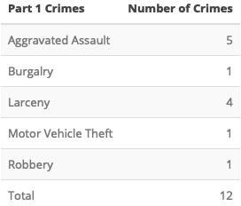

WUMC
August 2019 – Total Crimes
WUMC
August 2019 – Larceny Breakdown
Type of Larceny
All Other | 0
Bicycle | 1
From Building | 2
From Coin Machine | 0
From Motor Vehicle | 0
Motor Vehicle Parts | 1
Purse Snatching | 0
Shoplifting | 0
Total | 4
Monetary Value
Under $500 | 2
$500 - $24,999 | 2
Over $25,000 | 0
Total | 4

Slide 22
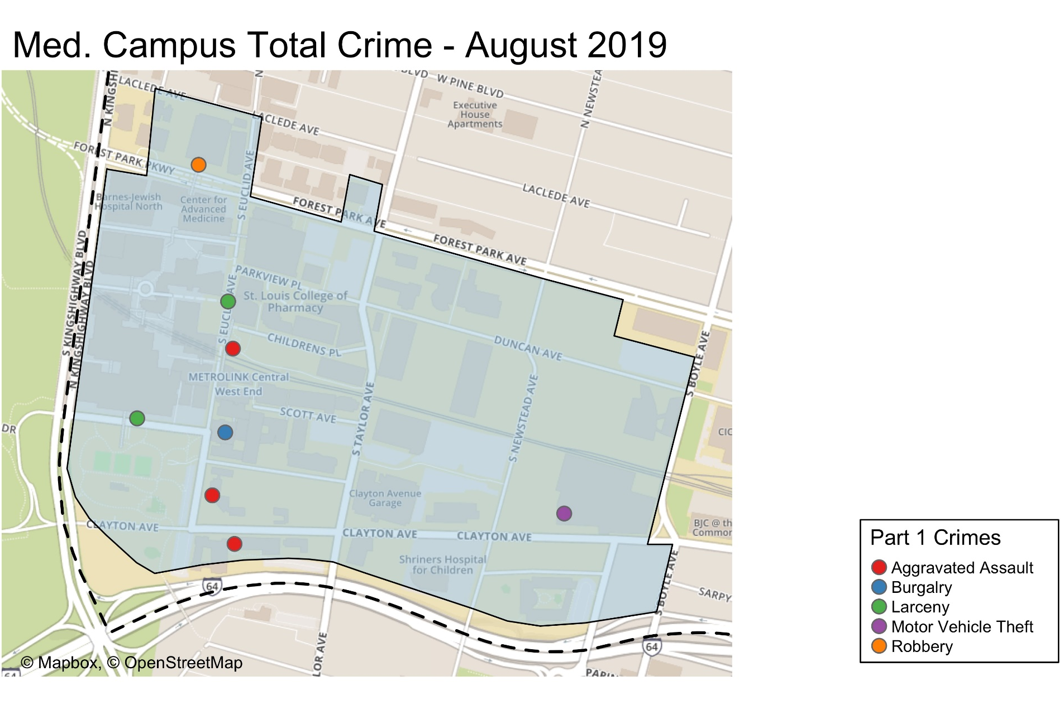

Slide 23
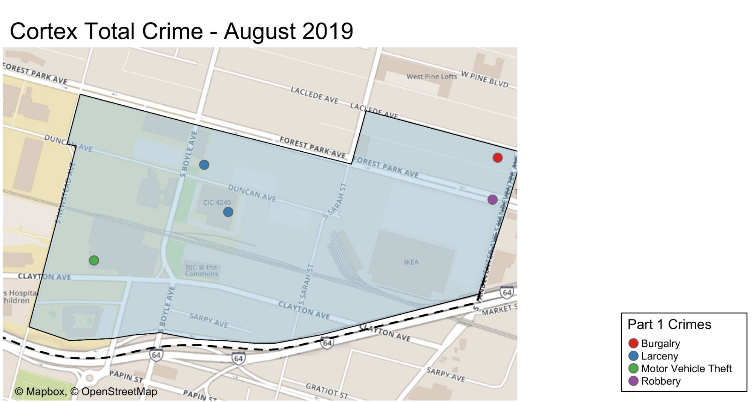

Slide 24
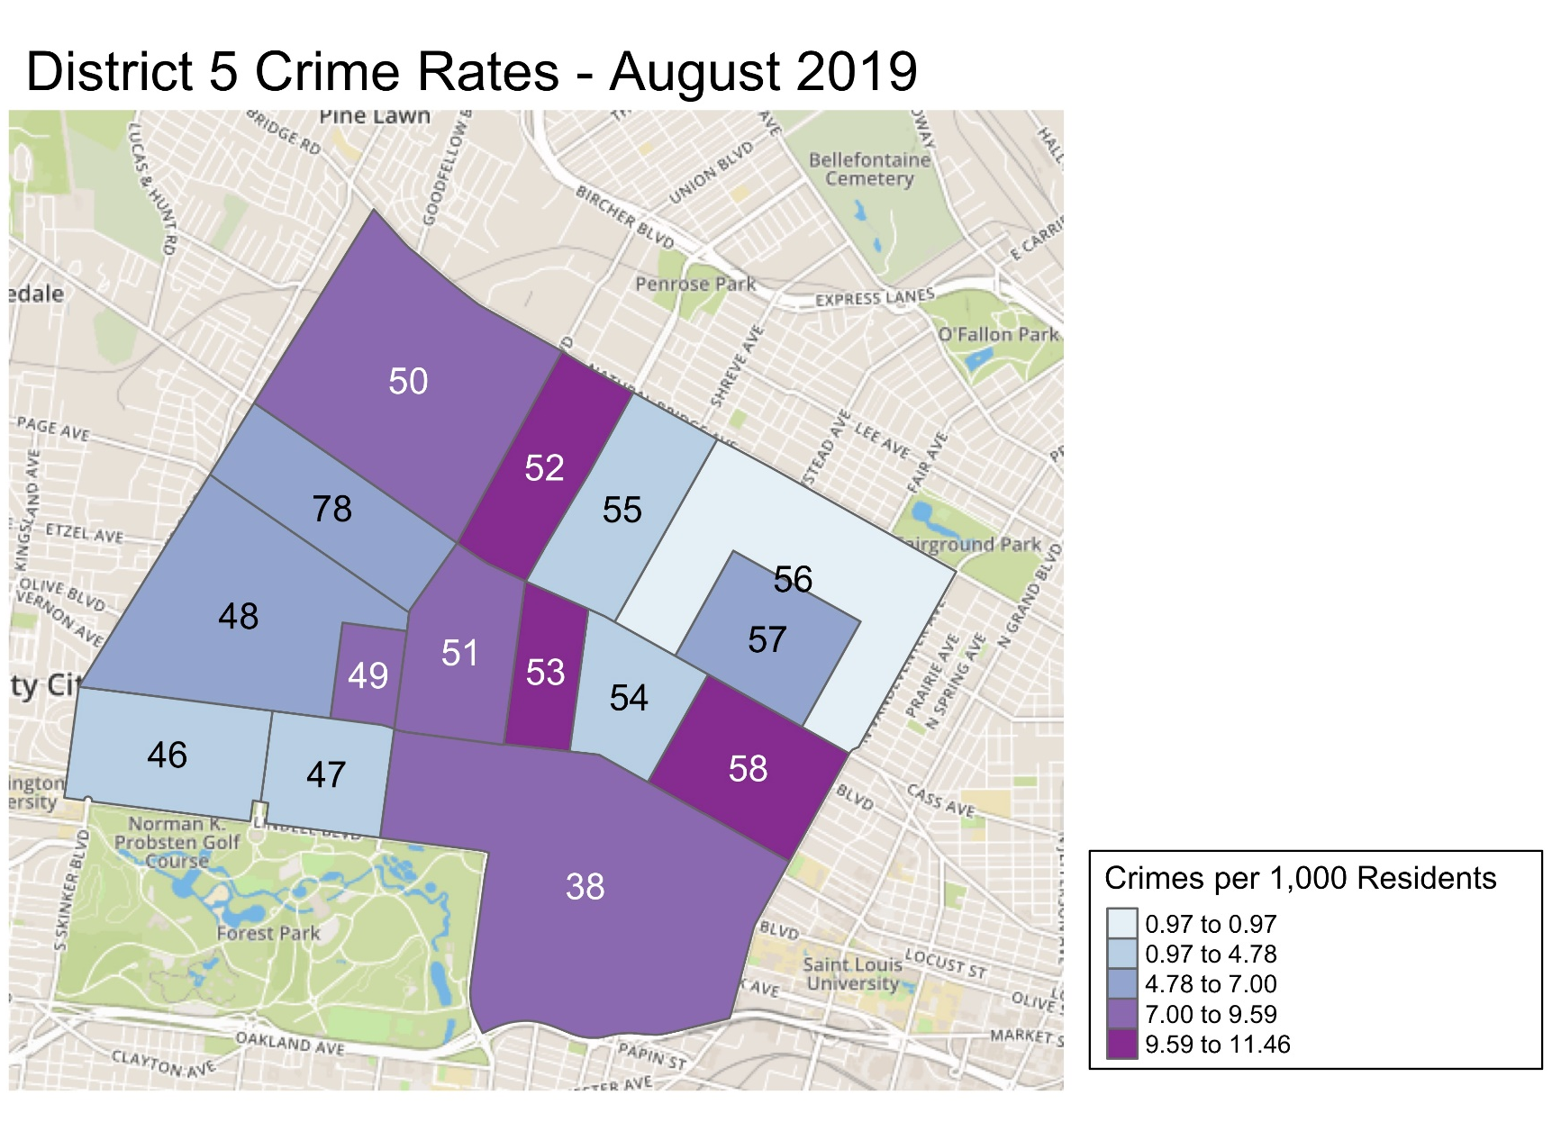
*Kingsway East and The Greater Ville neighborhoods are split between District 5 and District 6.

Slide 25
District 5 Density Map Explanation
District 5 Map
There are 15 neighborhoods in District 5.
The minimum number of crimes in one neighborhood was 6 (Greater Ville).
The maximum number of crimes in one neighborhood was 126 (Central West End).
The mean number of crimes for the district was 27.27.
Crime Rate
The crime rate was calculated using the population data from the 2010 census data.
The minimum crime rate was 3.13 crimes per 1,000 people (Visitation Park).
The maximum crime rate was 11.45 crimes per 1,000 people (Fountain Park).
The mean crime rate for the district was 7.00 crimes per 1,000 people.

Slide 26
Appendix 1
Forest Park Southeast Neighborhood Detail

Slide 27
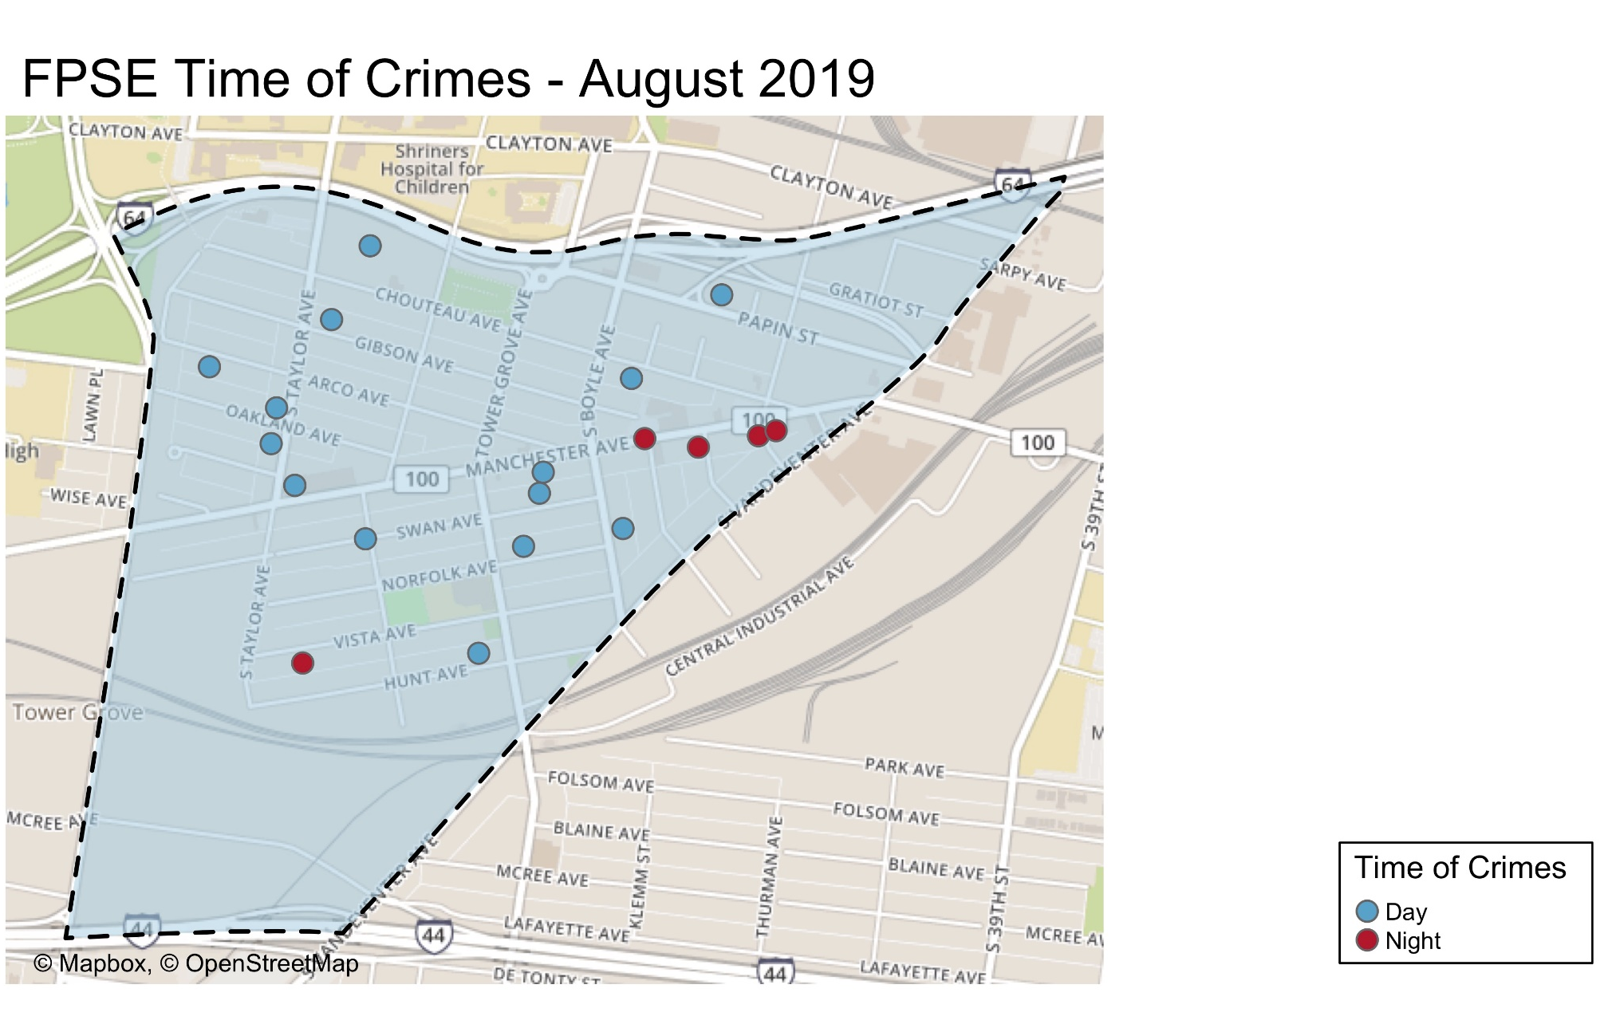

Slide 28
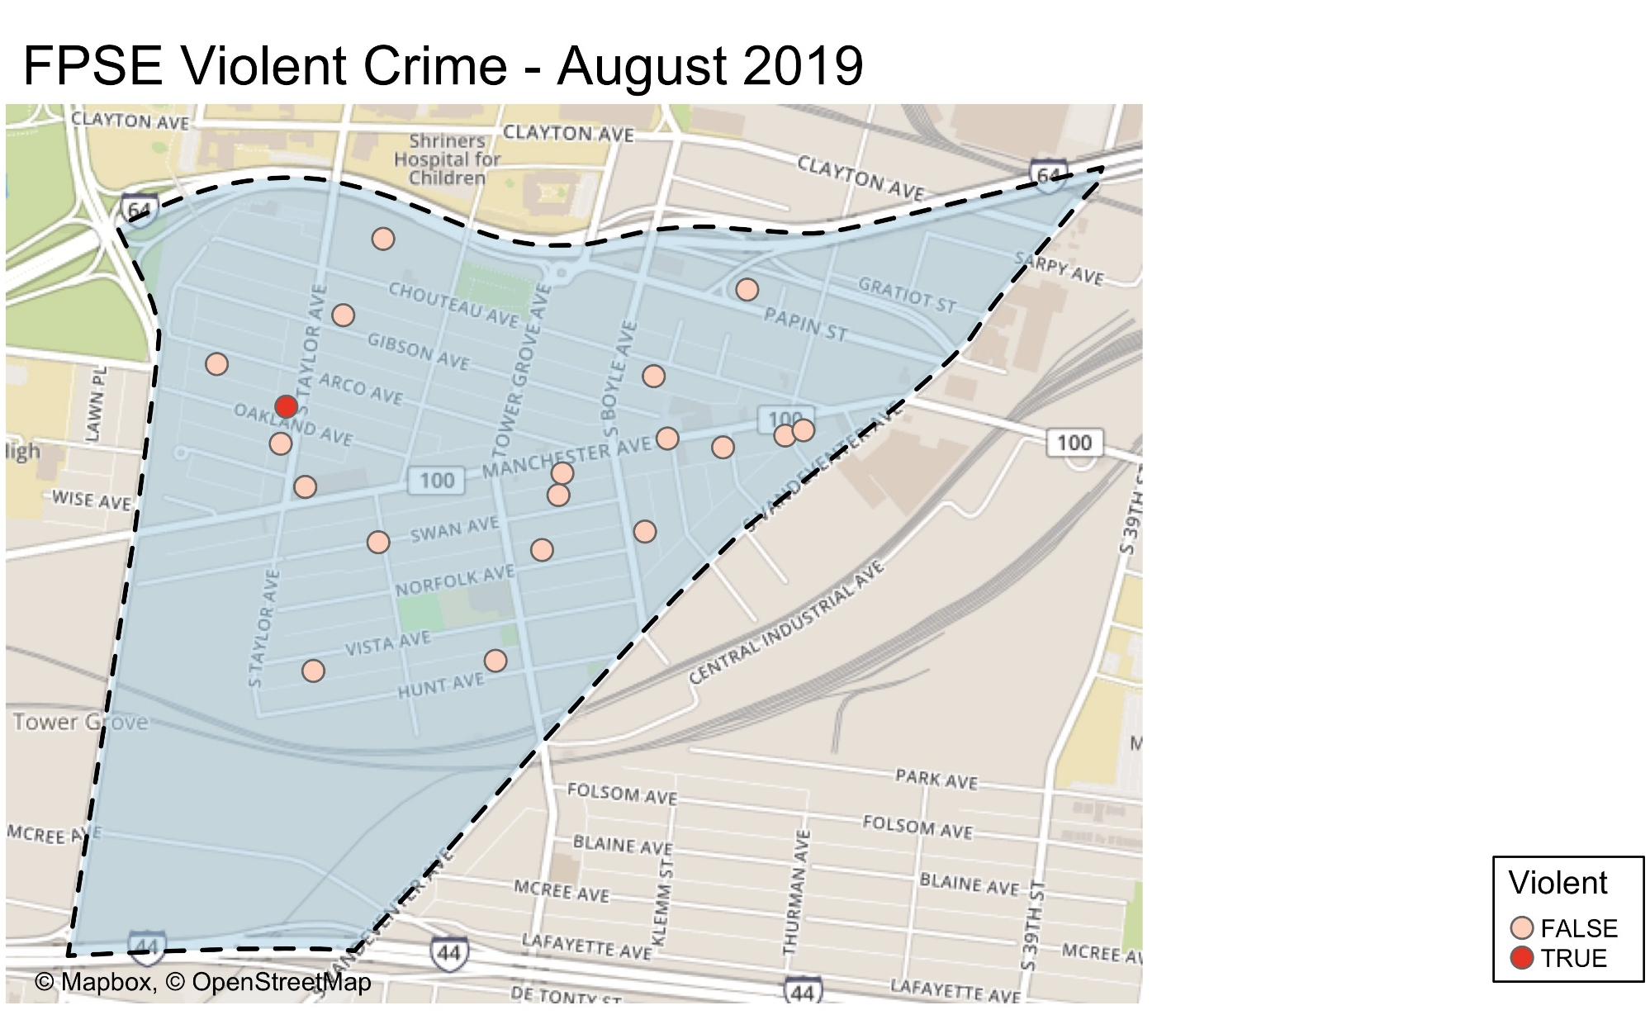

Slide 29
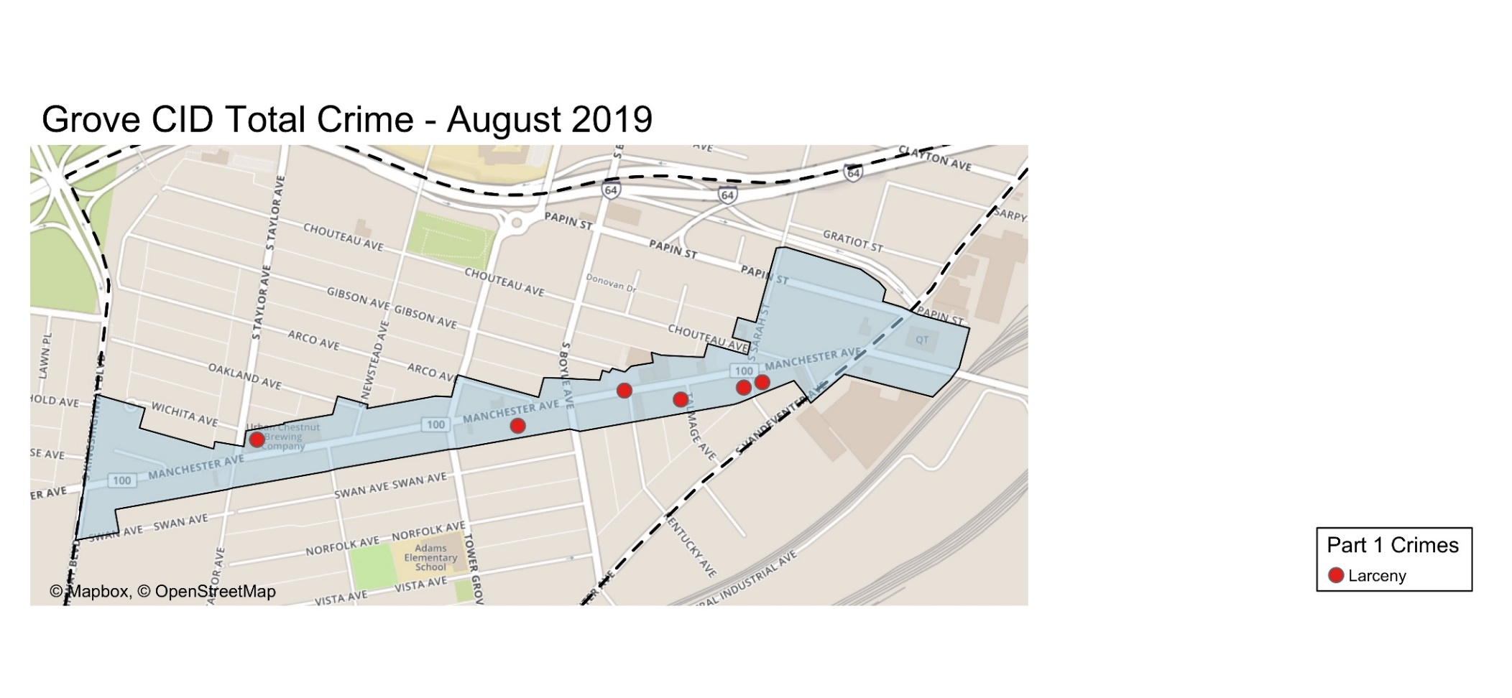

Slide 30
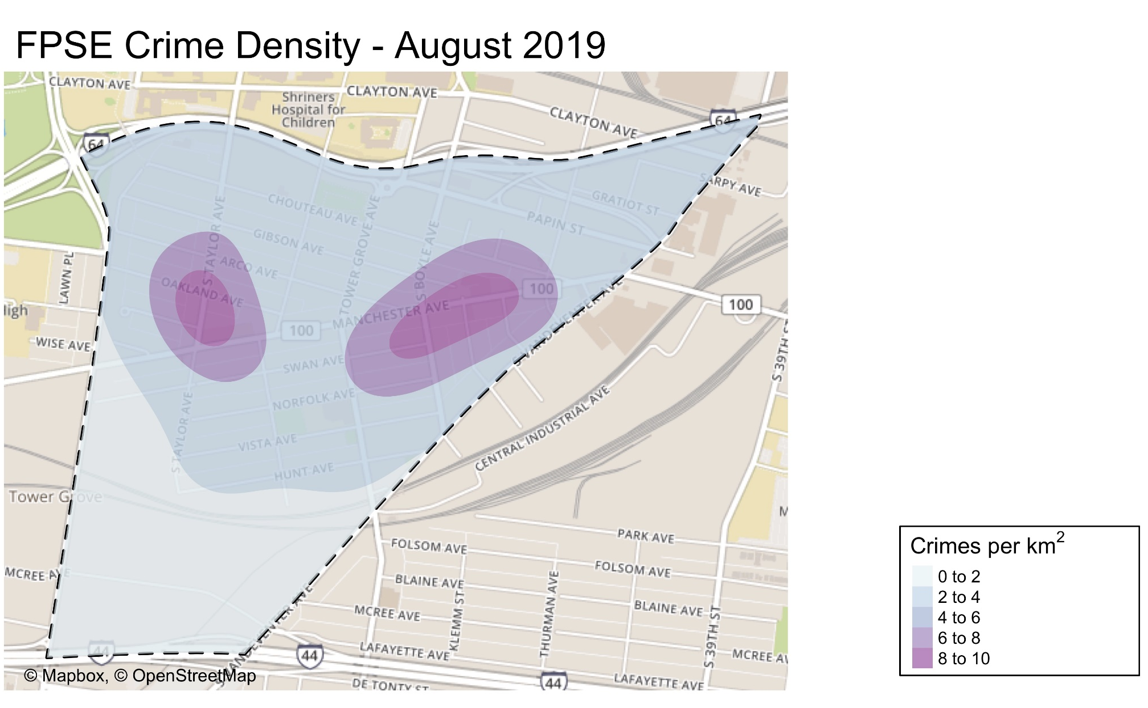

Slide 31
FPSE: August 2019 Larceny Breakdown
Type of Larceny
All Other | 4
Bicycle | 1
From Building | 2
From Coin Machine | 0
From Motor Vehicle | 8
Motor Vehicle Parts | 1
Purse Snatching | 0
Shoplifting | 1
Total | 17
Day
Sunday | 1
Monday | 1
Tuesday | 3
Wednesday | 2
Thursday | 6
Friday | 2
Saturday | 2
Total | 17
Monetary Value
Under $500 | 11
$500 - $24,999 | 6
Over $25,000 | 0
Total | 17
Time of Day
Day | 12
Night | 5
Total | 17

Slide 32
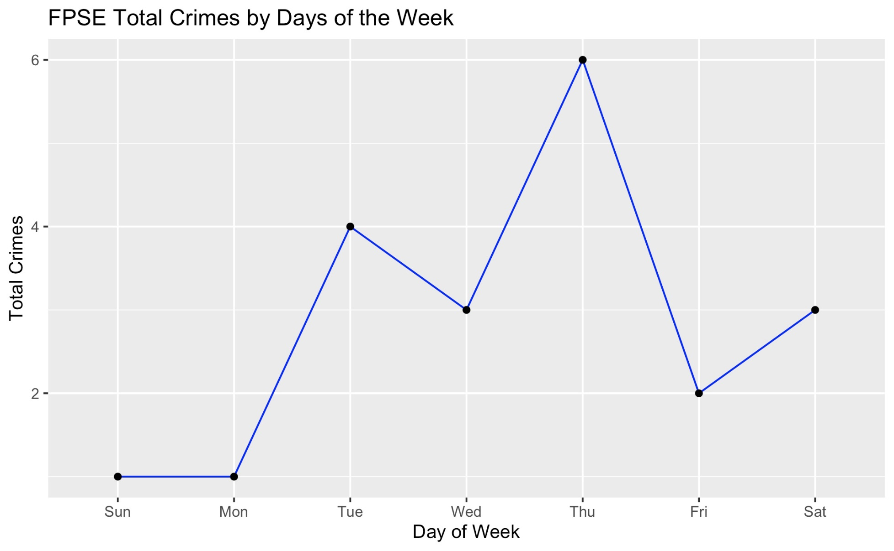

Slide 33
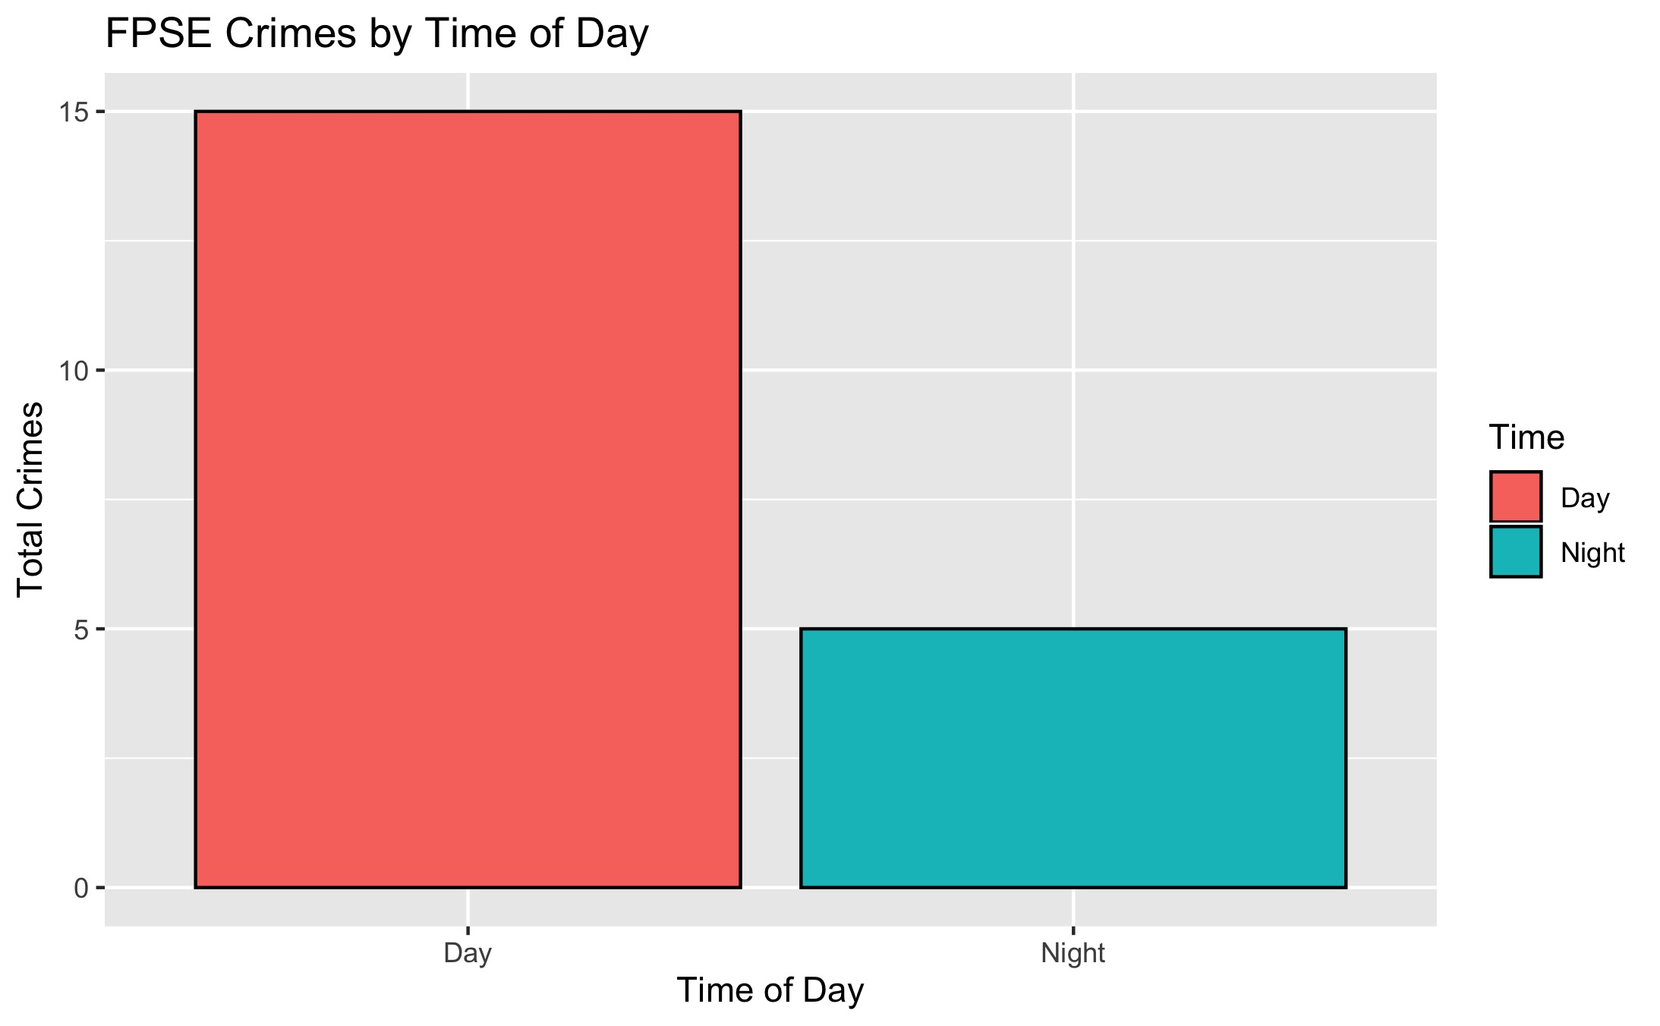

Slide 34
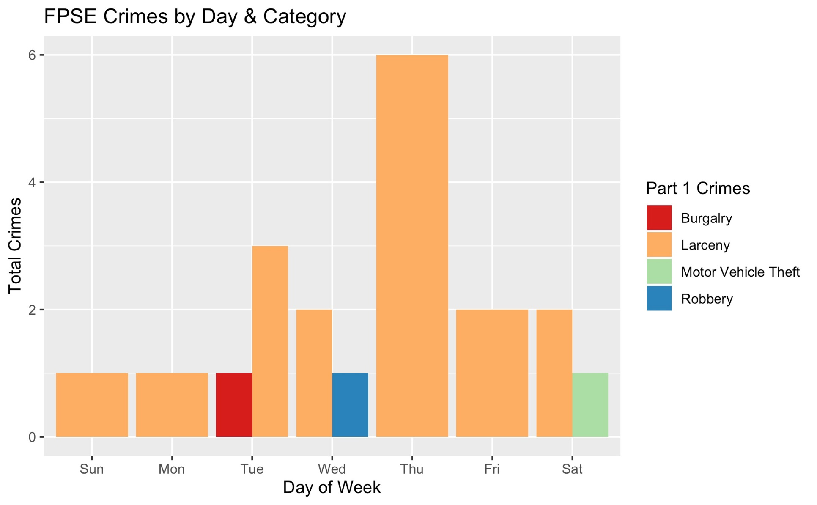

Slide 35
Appendix 2
Central West End Detail

Slide 36
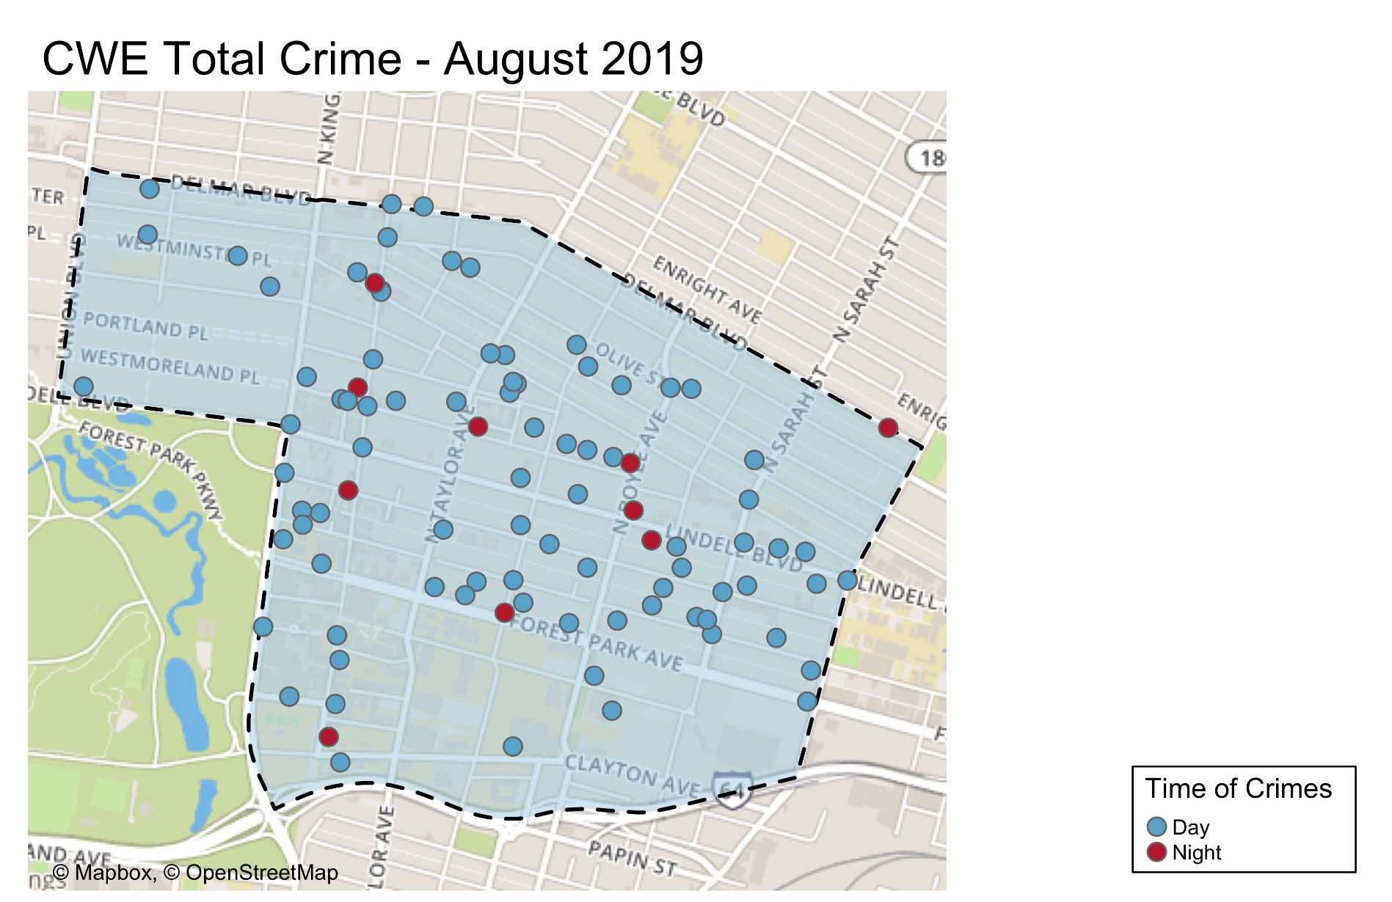

Slide 37
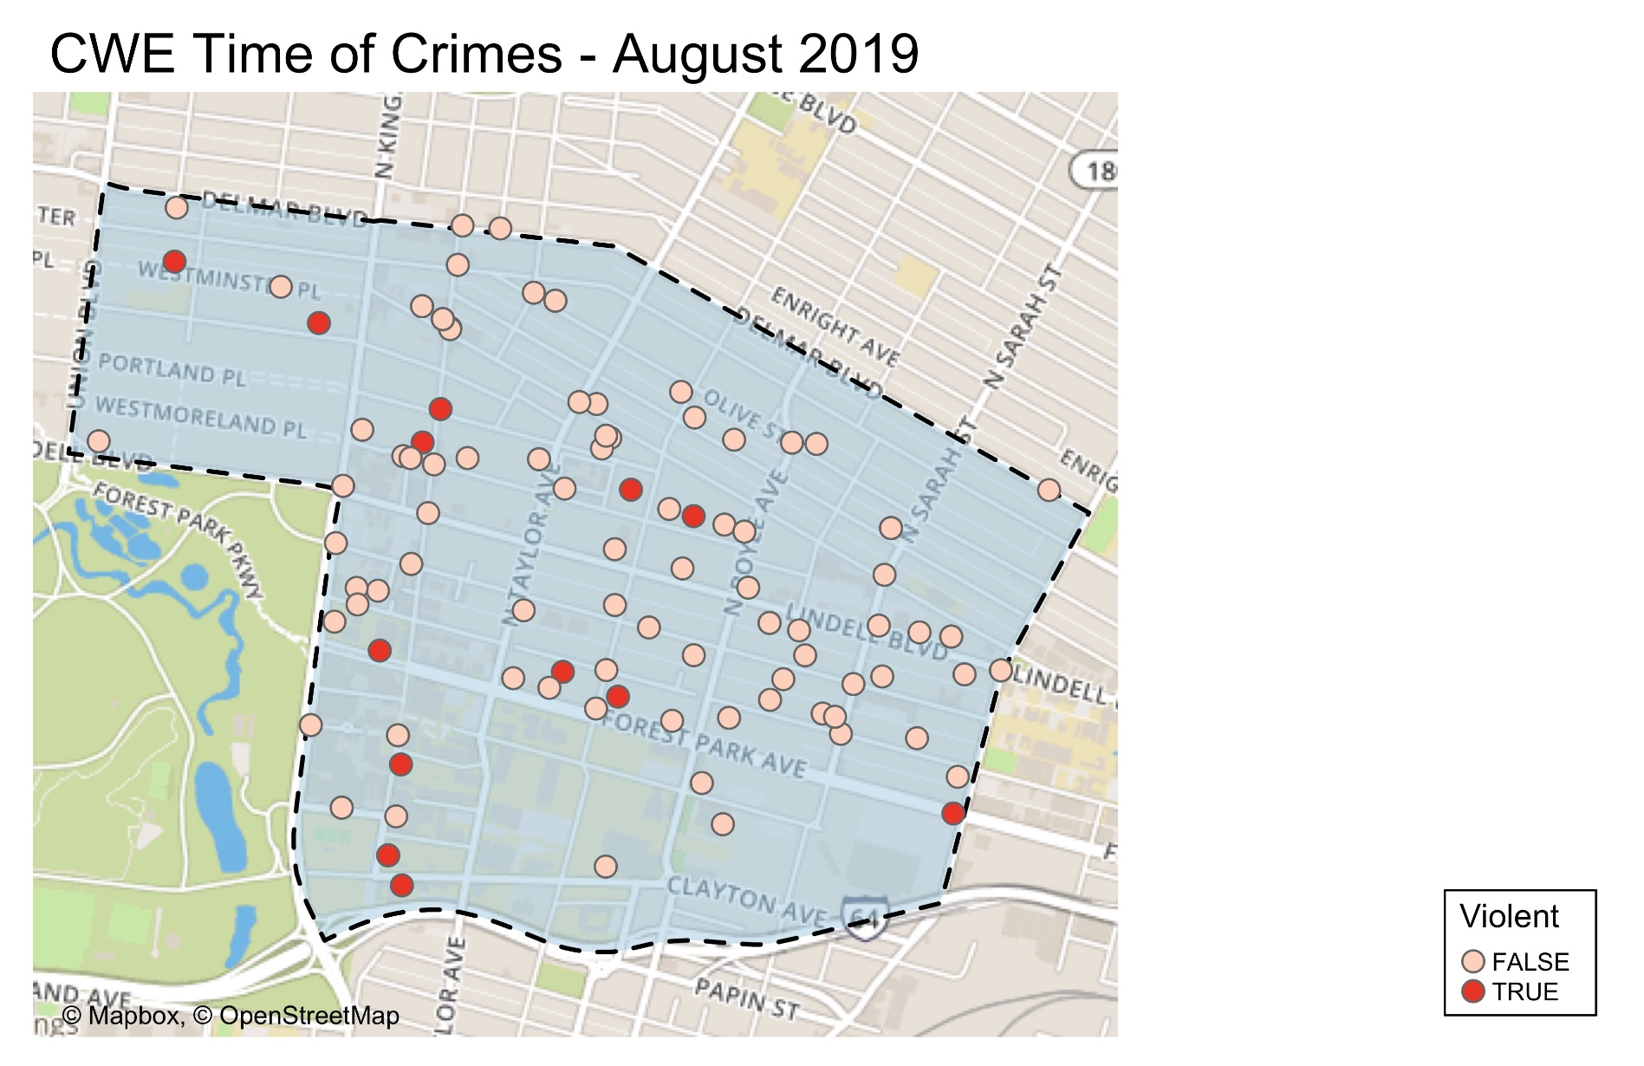

Slide 38
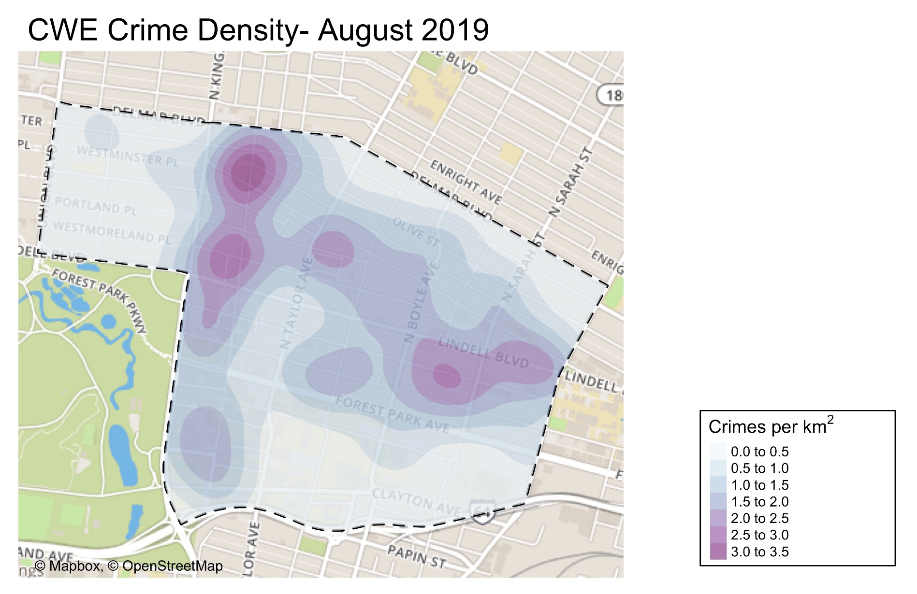

Slide 39
CWE: August 2019 Larceny Breakdown
Type of Larceny
All Other | 8
Bicycle | 5
From Building | 14
From Coin Machine | 0
From Motor Vehicle | 29
Motor Vehicle Parts | 12
Purse Snatching | 0
Shoplifting | 8
Total | 76
Day
Sunday | 6
Monday | 11
Tuesday | 7
Wednesday | 13
Thursday | 11
Friday | 19
Saturday | 9
Total | 76
Monetary Value
Under $500 | 53
$500 - $24,999 | 22
Over $25,000 | 1
Total | 76
Time of Day
Day | 66
Night | 10
Total | 76

Slide 40
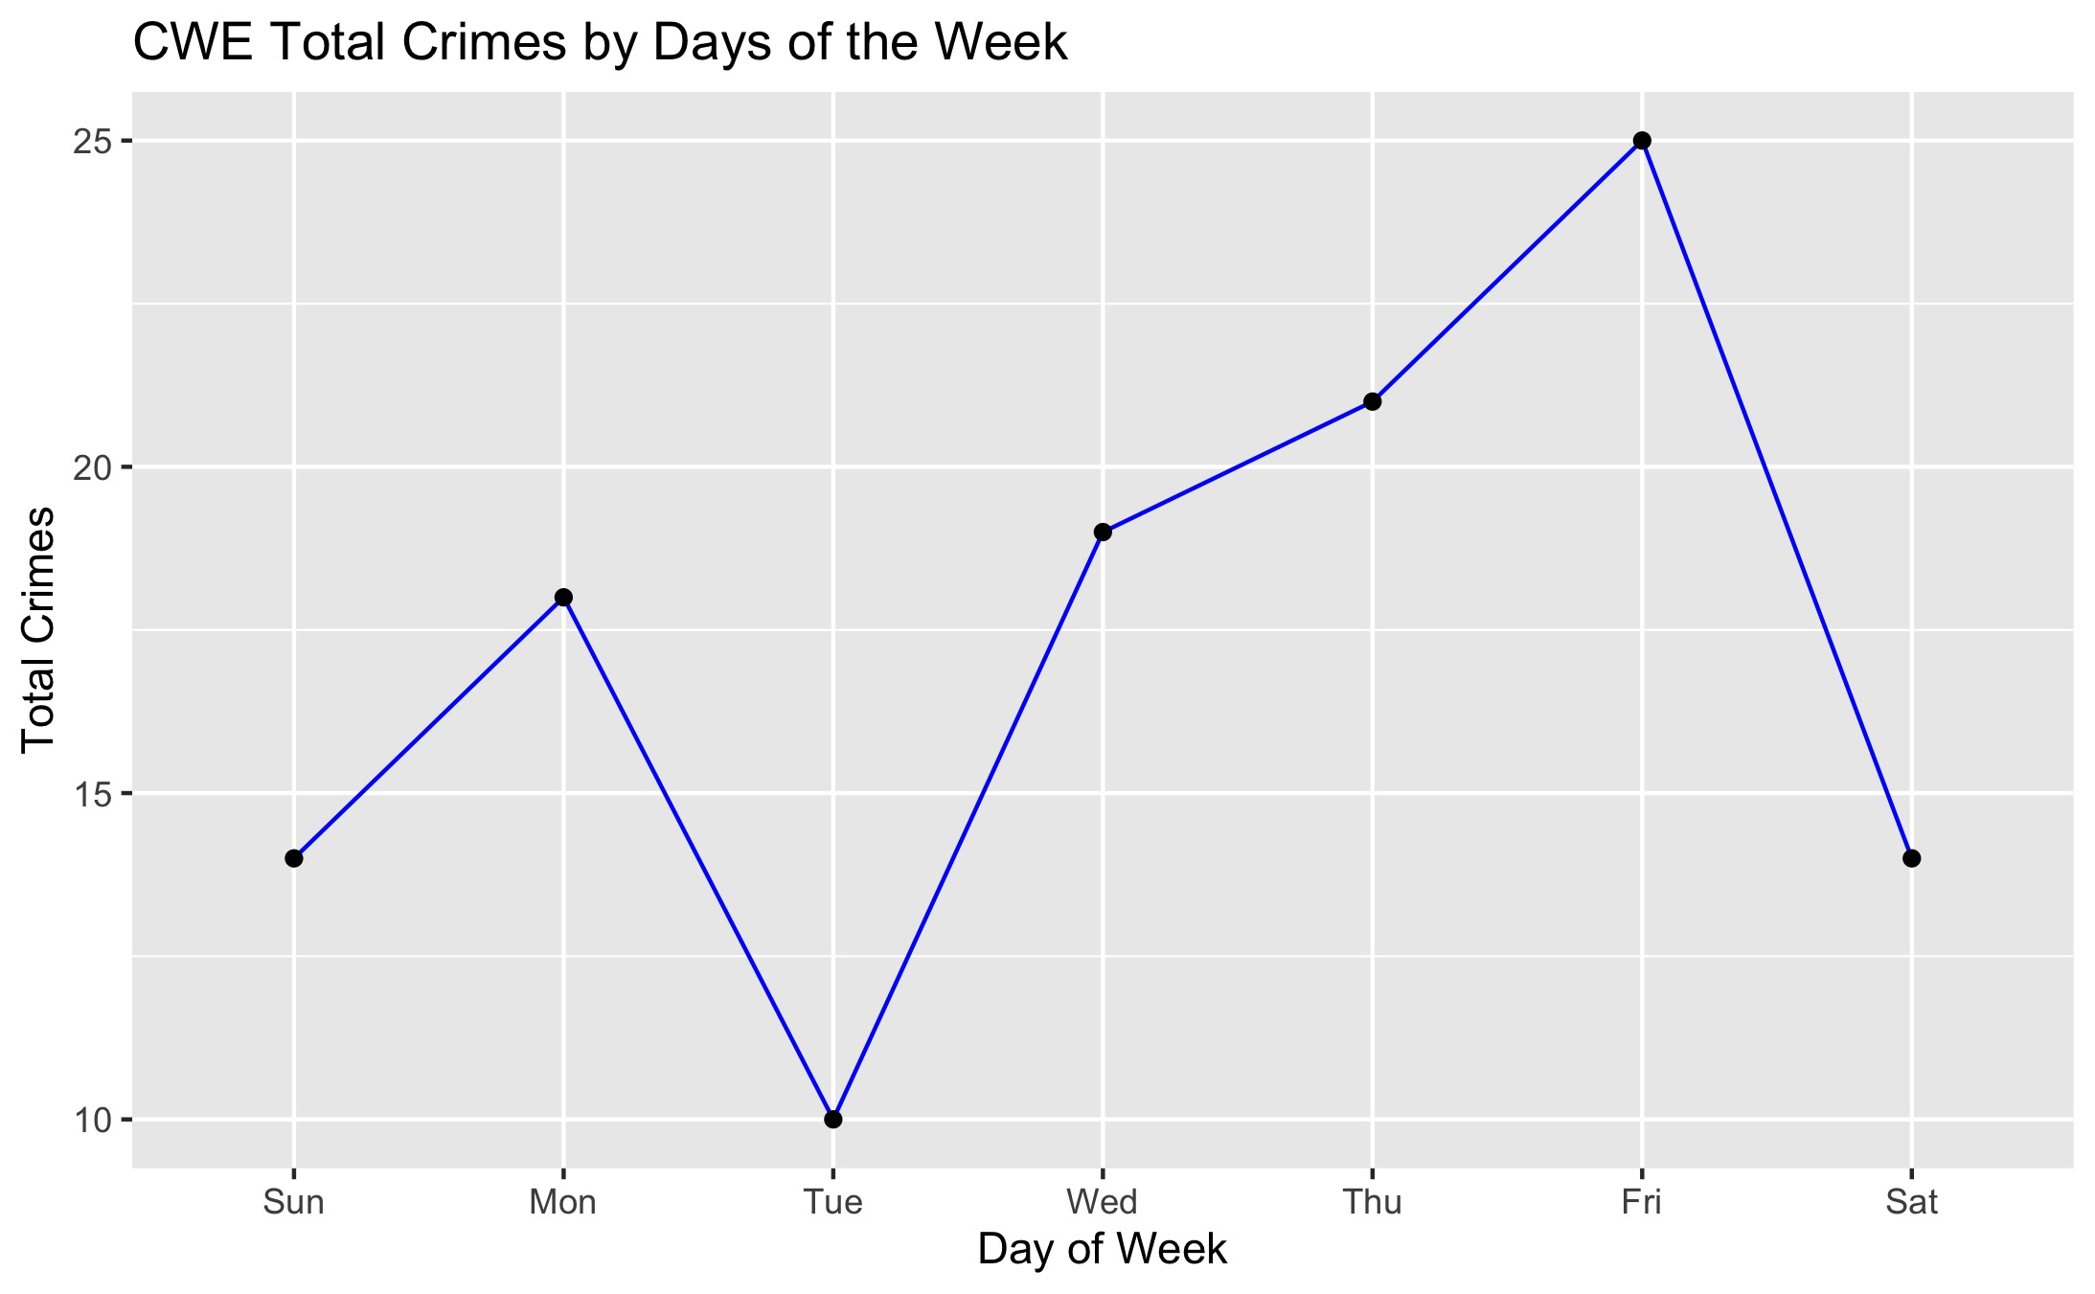

Slide 41
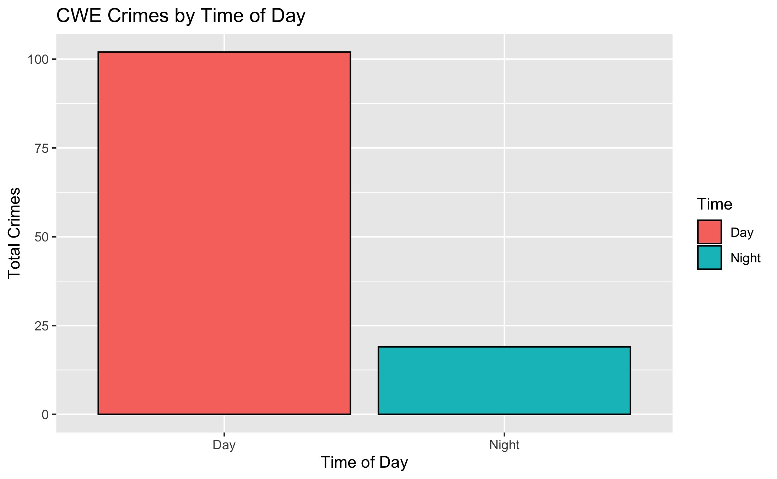

Slide 42
